Slide 1
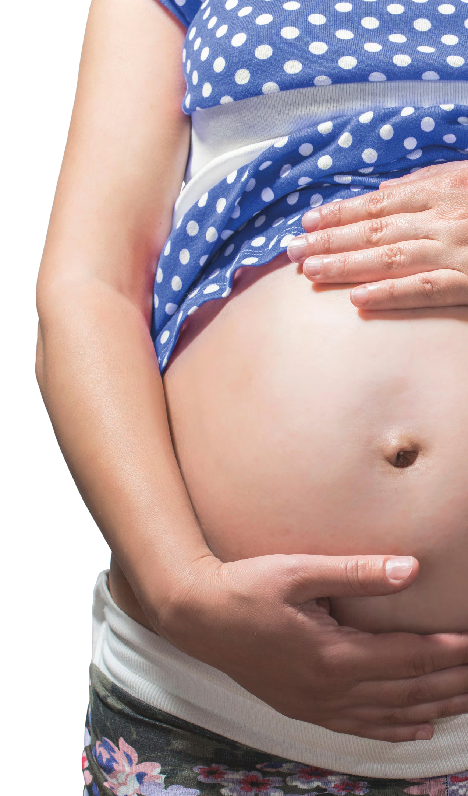
Notes:
Welcome to the #DRYMESTER learning session where we’ll be providing information about the effects of drinking alcohol during pregnancy, to encourage healthy pregnancies, for yourselves and loved ones.

Slide 2
Notes:
Some may see this as a shock, some may not be surprised. As a society, we turn to alcohol when we’re celebrating, when we’re stressed, when we’re socialising and when we just want to chill out. It’s society’s acceptable drug, a part of everyday life. There can be a lot of pressure to drink alcohol, so whilst pregnant, it could be difficult to avoid.

Slide 3
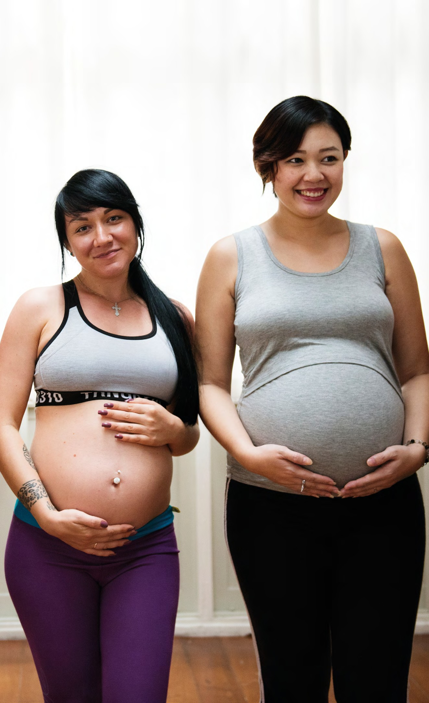
Notes:
But it isn’t good for the baby. Drinking alcohol during pregnancy could lead to complications, like miscarriage, stillbirth, prematurity and Fetal Alcohol Spectrum Disorder.

Slide 4
Notes:
Fetal Alcohol Spectrum disorder is a range of lifelong disabilities including developmental, physical, mental, emotional and learning impairments. It’s commonly misdiagnosed, some symptoms are similar to ADHD symptoms or to those being on the autistic spectrum, or without a diagnosis, it’s assumed the person has had a poor upbringing, or that they’re just poorly behaved.

Slide 5
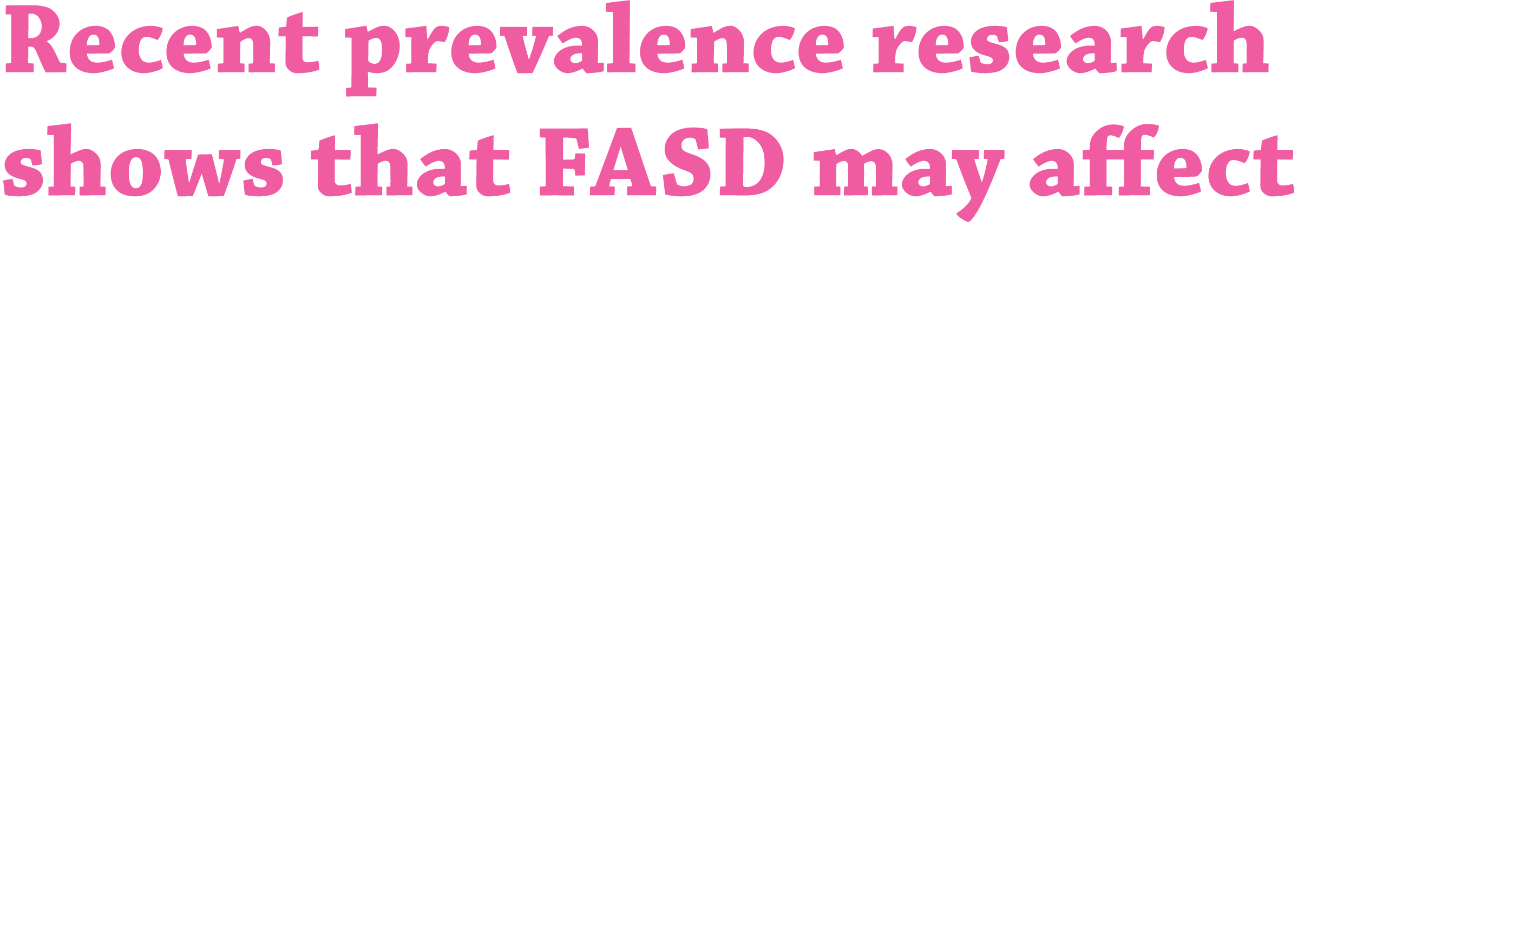
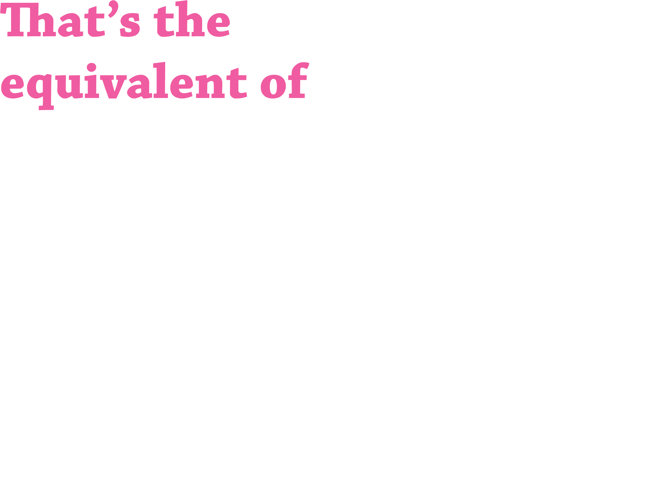
Notes:
A prevalence study was carried out last year to find out how many children and families in the Greater Manchester could be affected by FASD. Based on assessing factors known to be related to FASD, it was found that up to 3.6% of children may be affected which is the equivalent of 1,238 children born each year. That’s 1,238 cases of FASD we can avoid if we can all work together to help raise awareness of the effects of drinking alcohol during pregnancy.

Slide 6
Notes:
Allow this slide to play without clicking.
These are the variety of symptoms somebody with FASD could have but there’s no typical set and they can vary by case. FASD is not always recognisable and less than 10% of those with FASD will have the recognisable facial features shown, so its usually difficult to diagnose.

Slide 7
Notes:
Allow the slide to play without clicking.
Here is an example of an 18 year old with FASD, their skills and what they can do are completely varied, and as mentioned would vary by case.

Slide 8

Notes:
This is an experiment that you can carry out to show how alcohol reacts and how toxic it can be. The egg represents the fetus. You can delete the slide when presenting it or if you don’t want to carry out the experiment, delete both slides 8 and 9.

Slide 9
Notes:
This is the slide that will be on screen whilst carrying out the experiment

Slide 10
Notes:
There’s no known safe amount of alcohol to drink during pregnancy so the Chief Medical Officers and NHS guidance states that if you’re pregnant or planning to become pregnant, the safest approach is not to drink alcohol at all to keep risks to your baby to a minimum. We want this message to be spread so we can help reduce cases of FASD.

Slide 11
Notes:
If any of the information in this presentation causes concern, there are plenty of places to go to for support as shown on the slide. (If there’s anybody in the workplace they can speak to, mention who that is. You could share the support handout as well).

Slide 12
Notes:
DRYMESTER is a campaign commissioned by Greater Manchester Health and Social Care Partnership to raise awareness of the risks of drinking alcohol during pregnancy. For more information you can visit the website.

