Slide 1
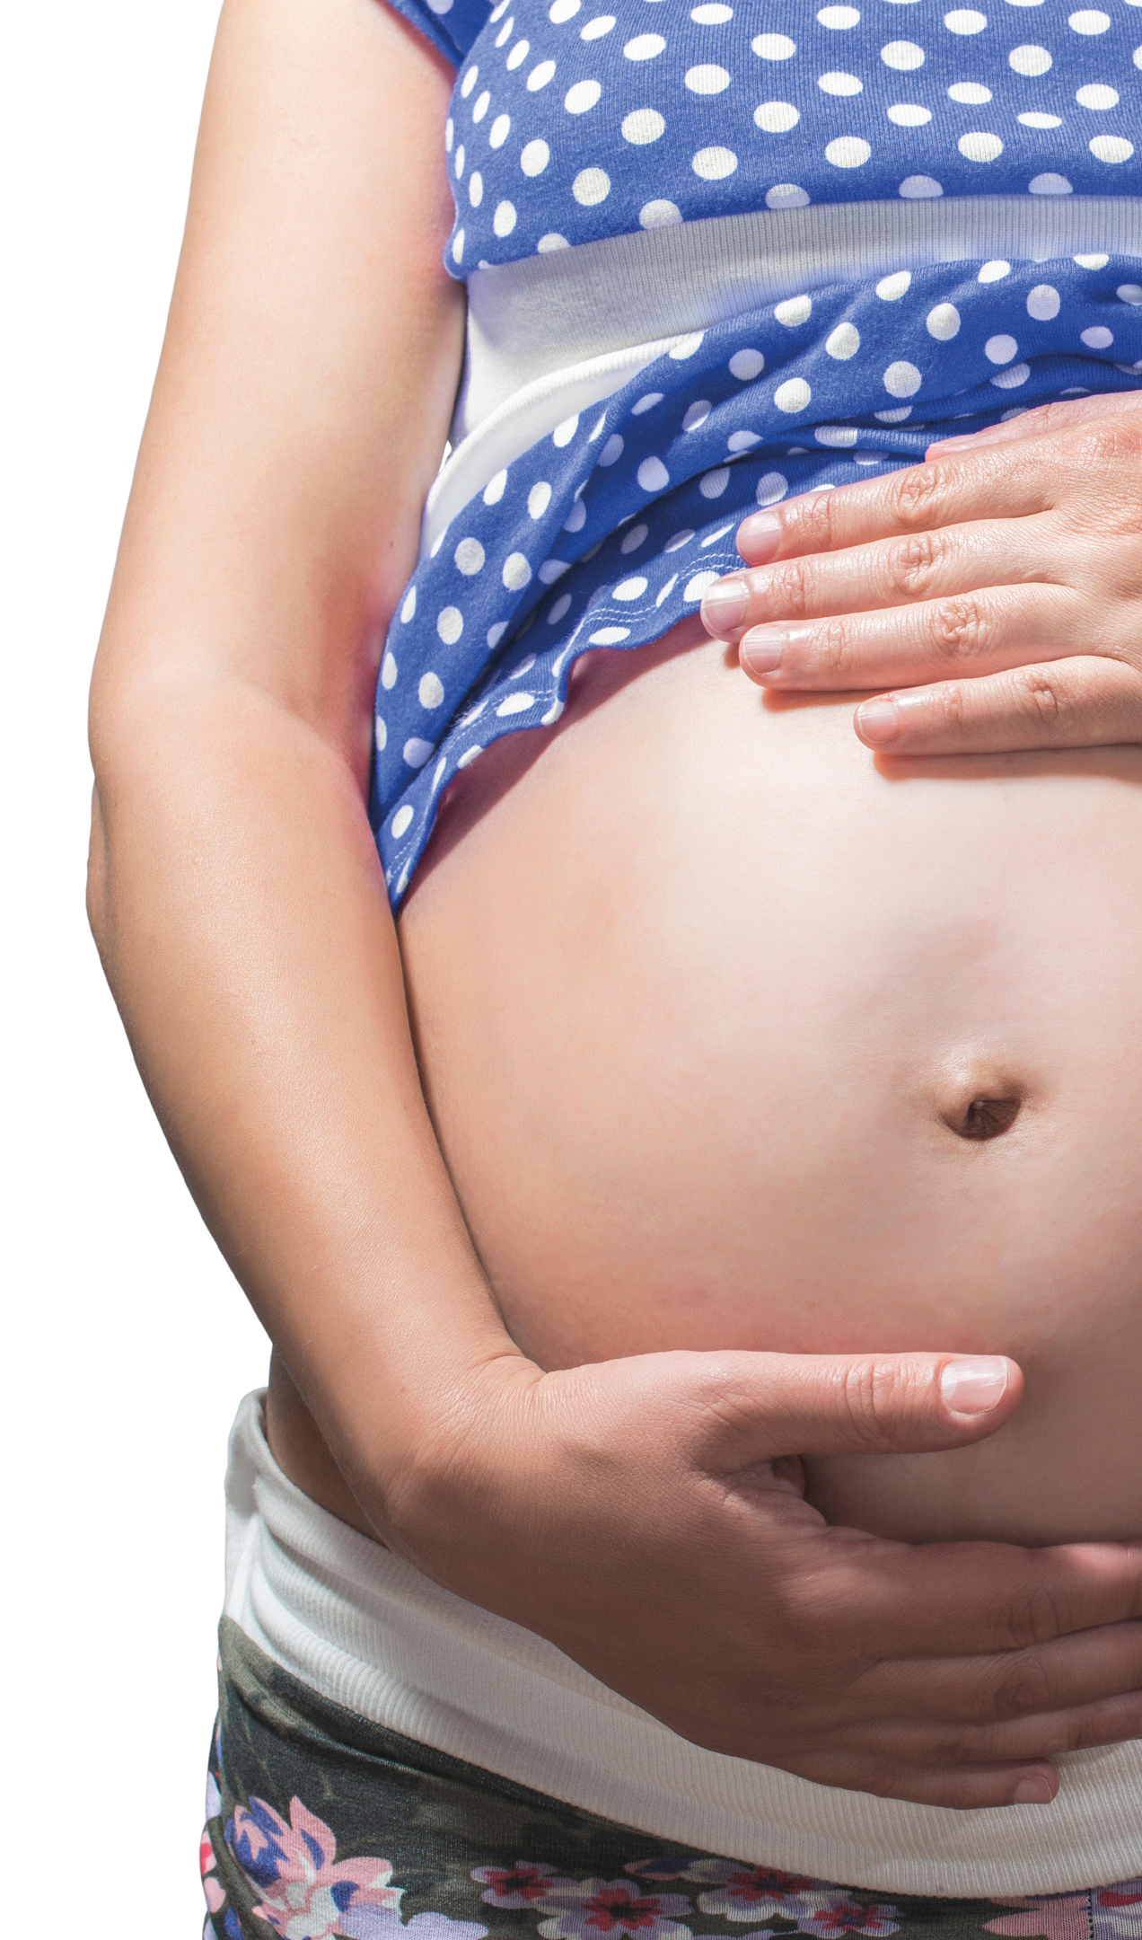
HELPING PARENTS-TO-BE GO ALCOHOL FREE
Notes:
Welcome to the #DRYMESTER learning session where we’ll be providing information about the effects of drinking alcohol during pregnancy, to encourage healthy pregnancies, for yourselves and loved ones.

Slide 2
OF PREGNANCIES IN THE UK ARE ALCOHOL-EXPOSED.
Notes:
Some may see this as a shock, some may not be surprised. As a society, we turn to alcohol when we’re celebrating, when we’re stressed, when we’re socialising and when we just want to chill out. It’s society’s acceptable drug, a part of everyday life. There can be a lot of pressure to drink alcohol, so whilst pregnant, it could be difficult to avoid.

Slide 3
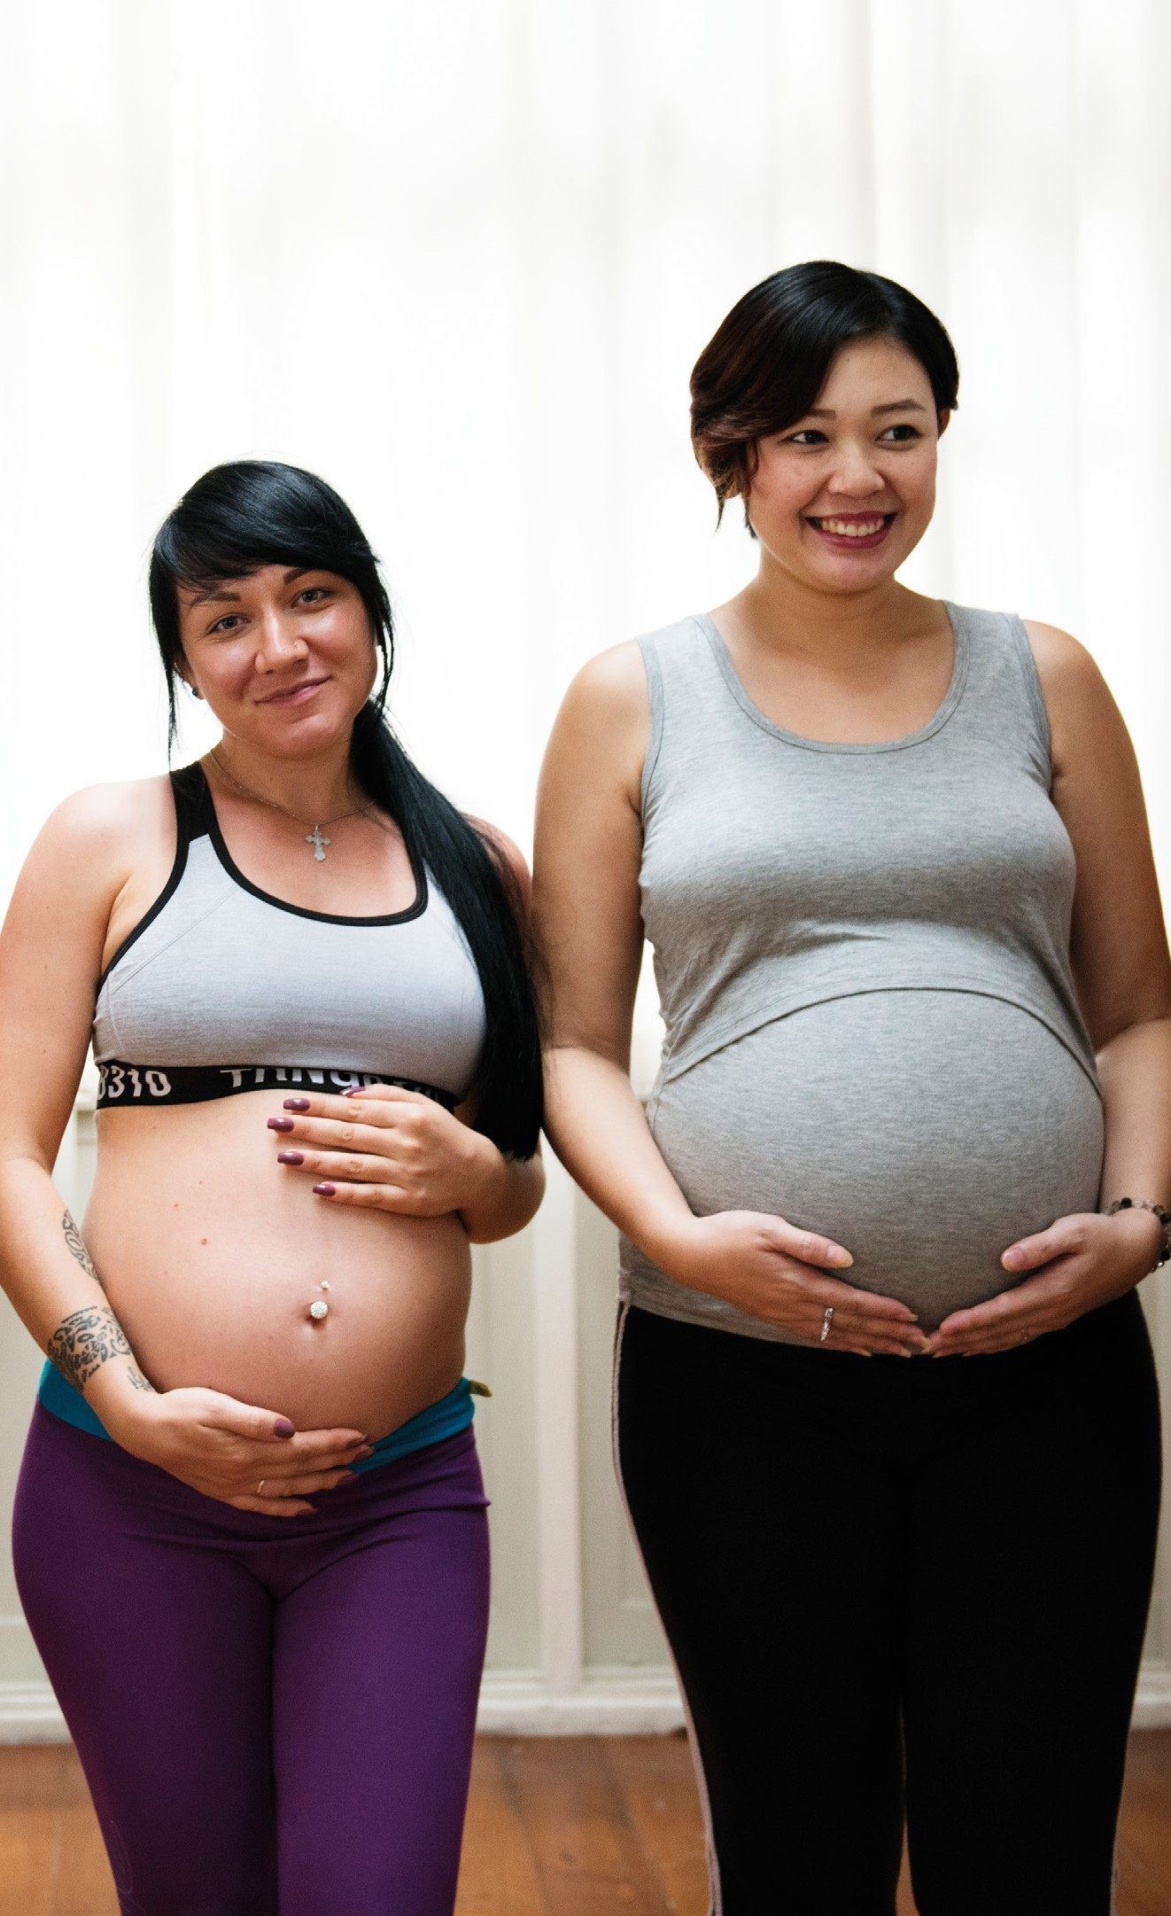
Notes:
But it isn’t good for the baby. Drinking alcohol during pregnancy could lead to complications, like miscarriage, stillbirth, prematurity and Fetal Alcohol Spectrum Disorder.

Slide 4
Notes:
Fetal Alcohol Spectrum disorder is a range of lifelong disabilities that include developmental, physical, mental, emotional and learning impairments.
There’s very little awareness about it so is commonly misdiagnosed, particularly with some symptoms being similar to ADHD or to those being on the autistic spectrum. Without a diagnosis, it can be assumed the person has behavioural problems or has had a poor upbringing which usually isn’t the case.
It can also lead to problems later in the life such as addiction, crime and homelessness if the person doesn’t get the right support.
It’s the leading known preventable intellectual disability and is only caused by prenatal alcohol exposure.

Slide 5
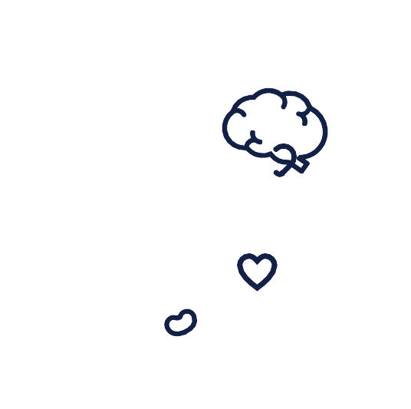
FASD CONDITIONS
Notes:
Allow this slide to play without clicking.
These are the variety of symptoms somebody with FASD could have — there’s no typical set and they can vary by case.
Less than 10% of those with FASD will have the recognisable facial features shown, making it even more difficult to diagnose.

Slide 6
Notes:
Allow the slide to play without clicking.
Here is an example of an 18 year old with FASD, their skills and what they can do are completely varied.
As mentioned there’s no typical set of symptoms, so this could be completely different from person to person.
People with FASD also have many strengths. Diagnosis and FASD-informed support helps create brighter futures.

Slide 7
FASD IN HERTFORDSHIRE AND ESSEX
That’s the equivalent of approximately
1,202
children born each year in Hertfordshire and Essex.
of children.
Notes:
A prevalence study was carried out in Greater Manchester to find out how many children and families could be affected by FASD.
Based on assessing factors known to be related to FASD, it was found that up to 3.6% of children may be affected — which is the equivalent of 1,202 children born each year in Hertfordshire and Essex.
That’s 1,202 cases of FASD we can avoid if by helping to raise awareness of the effects of drinking alcohol during pregnancy.

Slide 8
Notes:
This slide is the instructions for an experiment that demonstrates alcohols effect to an egg (which represents the fetus). Delete slide when presenting if you want to include this experiment.

Slide 9
Notes:
This is the slide that will be on screen whilst carrying out the experiment

Slide 10
Notes:
There’s no known safe amount of alcohol to drink during pregnancy so the Chief Medical Officers and NHS guidance states that if you’re pregnant or planning to become pregnant, the safest approach is not to drink alcohol at all to keep risks to your baby to a minimum. We want this message to be spread so we can help reduce cases of FASD.

Slide 11
For FASD and alcohol support service in your area visit: drymester.org.uk/he
For free and helpful tips and resources to help parent-to-be go alcohol free during pregnancy, visit: drymester.org.uk/he
Notes:
If any of the information in this presentation causes concern, there are plenty of places to go to for support as shown on the slide.

Slide 12
HELPING PARENTS-TO-BE GO ALCOHOL FREE
For more information visit
www.drymester.org.uk/he

